Slide 1






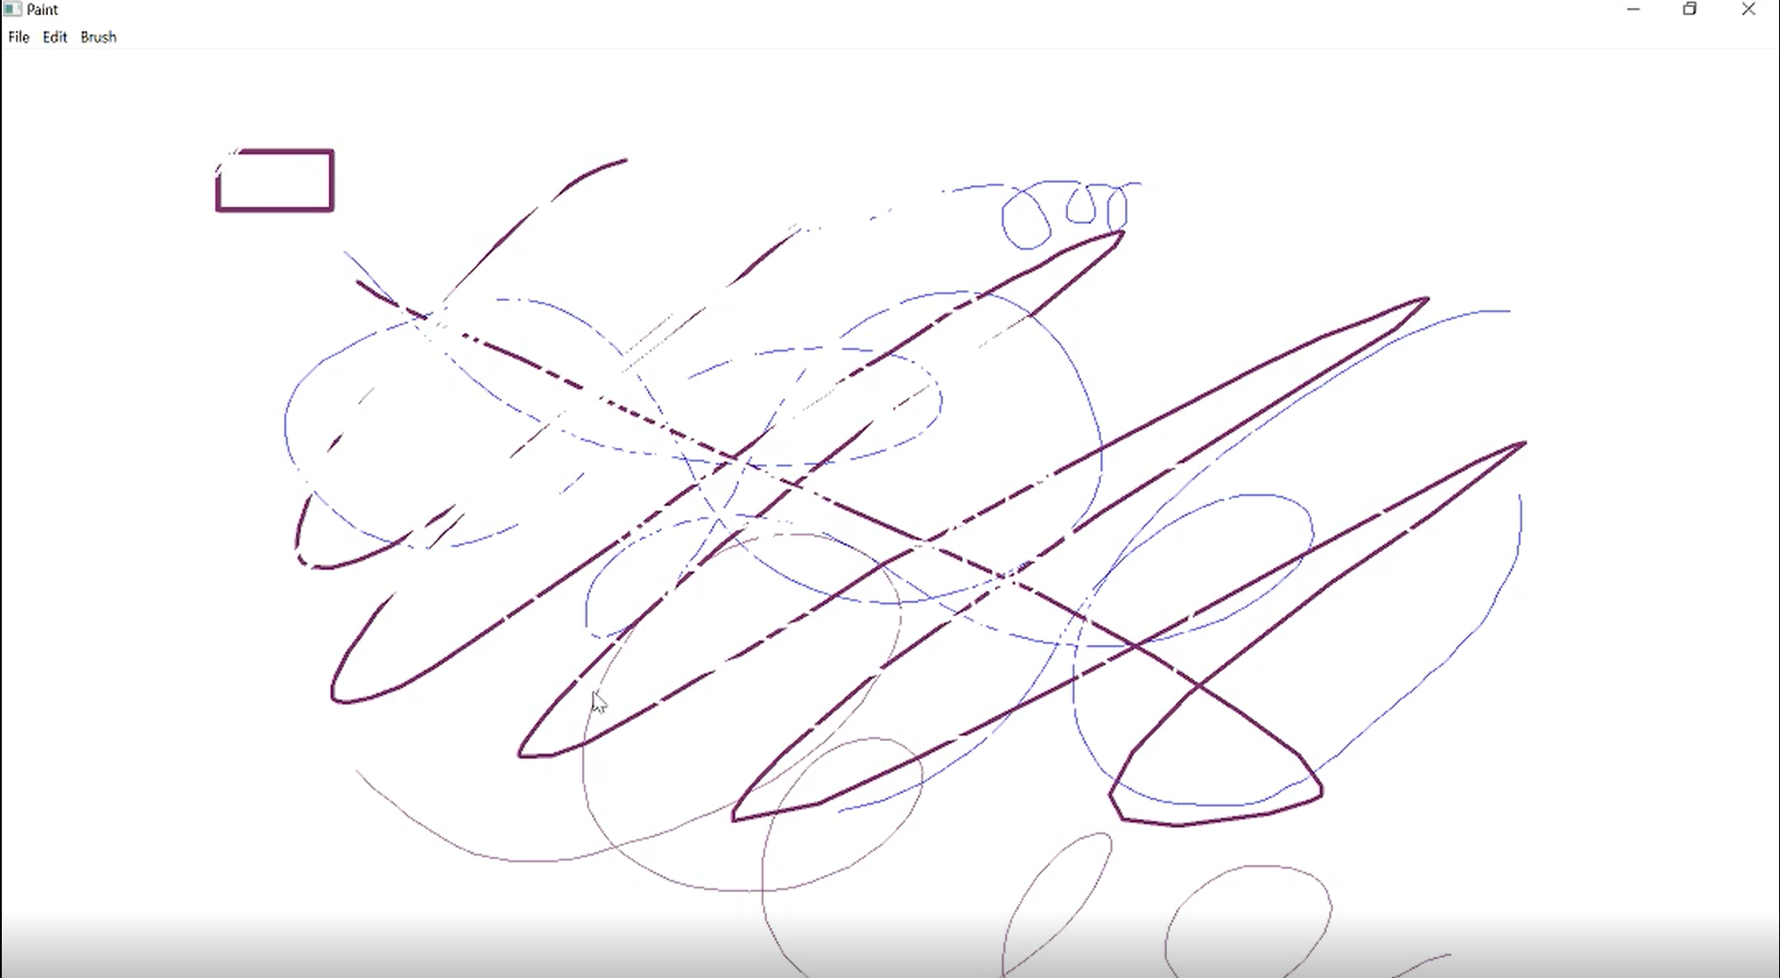
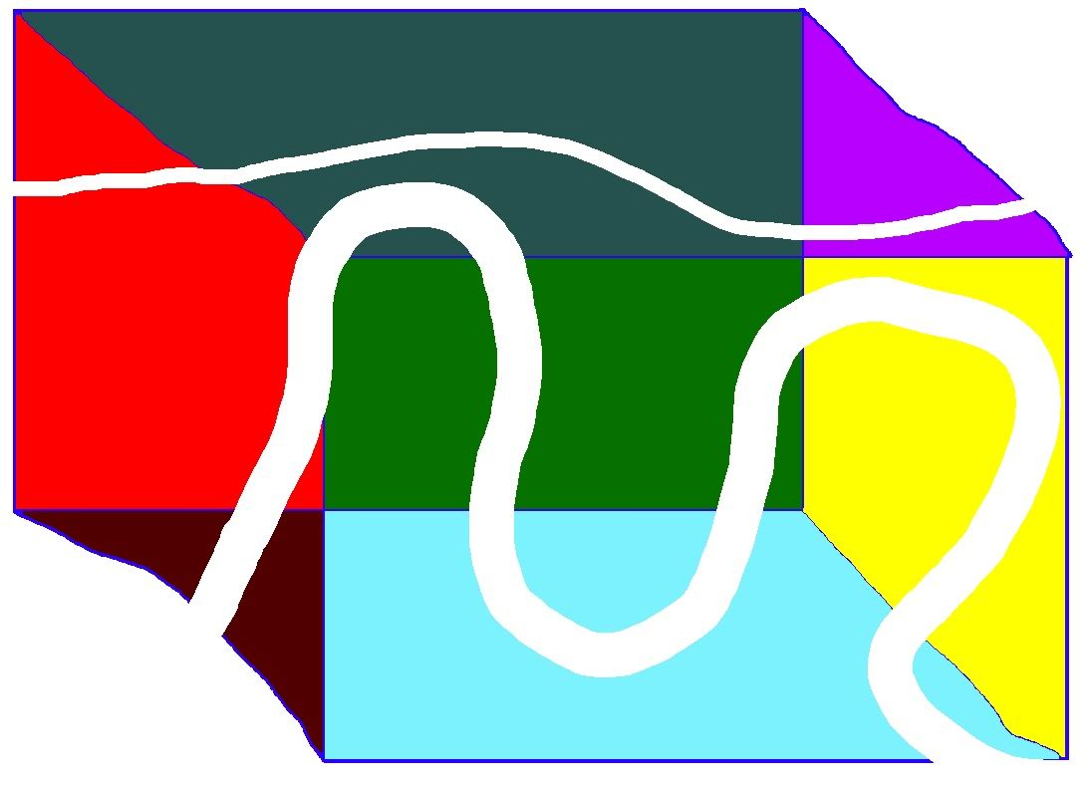

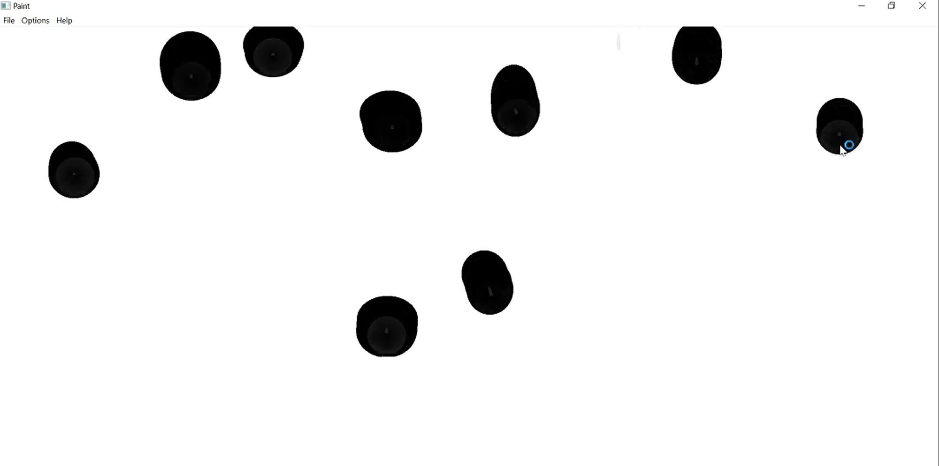
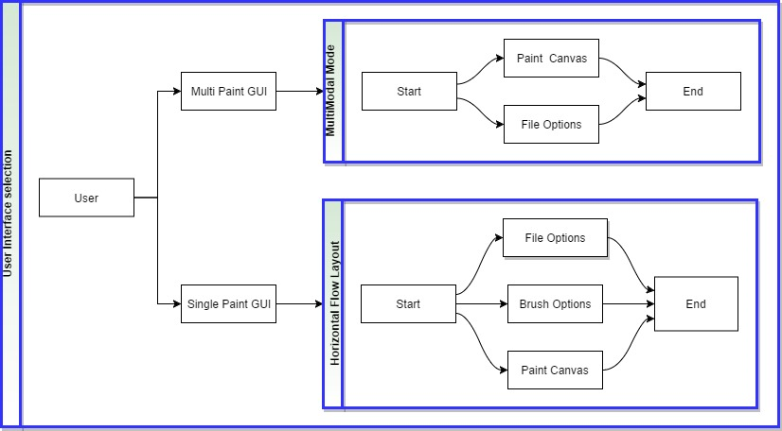
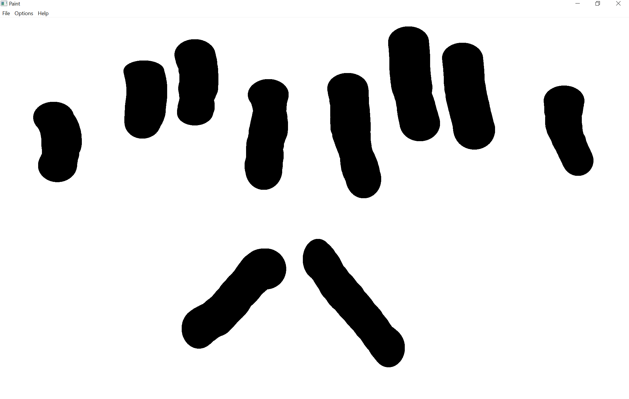
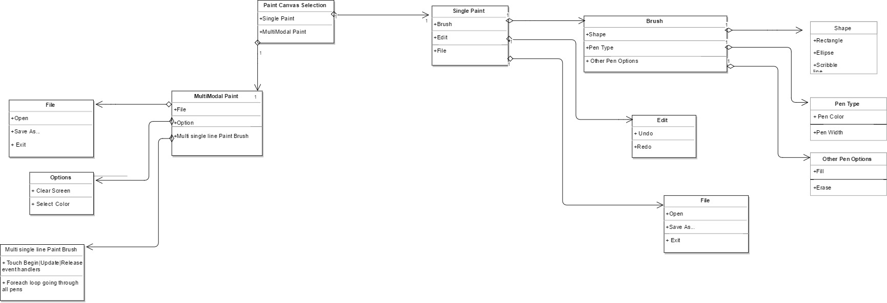
School of Computing & Information Sciences
Senior Project, 2017, Spring
MultiModal Interactive Paint
Student: Jim Louro, Florida International University
Mentor: Francisco Ortega, Florida International University
Instructor: Masoud Sadjadi, Florida International University
Problem
This project is designed to implement multi touch on a painting application that simultaneously accepts several inputs, from a variety of devices.
The issue came with the programs dependency to several SDK’s and different frameworks, causing the environment required to compile not be able to compile.
Solution
Develop the GUI with the QT framework so that we can have a canvas that handles multiple pens in free draw along with a canvas that handles a single pen touch but gives the user more options on what drawing they could make. Do so having as few dependencies as possible.
Current System
Runs using QT 5.8 and is backwards compatible to QT 4.8
Runs on Windows 7 and above
Accepts up to 10 inputs under MultiModal mode
Gives different shapes(figure 2), different color, undo redo erase(figure1) and fill option.
Gives free draw option that accepts from 1 to 10 inputs simultaneously.(figures 3&5)
Screenshots
Figure 1
Figure 2
Figure 3
Figure 4
Requirements
Pens width for single should be adjustable for all brushes
Pens color for single should be adjustable for all brushes
All shapes should be created and stored in order to allow undoing and redoing shapes
User can save the images on the canvas and load them at later time
User can use Eraser to remove specific pixels of the painting
In MultiModal Mode user can have up to 10 paint brushes working at once
In MultiModal Mode user can draw with only 1 brush then include up to 9 others without changing location of first pen
Qt will handle all touch events to reduce threads and dependencies
User can run the program with only needing a Qt version from 4.8 to latest
Implementation
This project Was built in C++ using the Qt framework
Classes that we used specific to Qt 4.8 and above include QtWidgets, QtApplication, and QtUtility.
We programmed and compiled code mostly in Visual Studios 15
System Design
Verification
Test case: Draw with Multiple brushes
Purpose: To test the ability to draw with Multiple pens on the same canvas at the same time.
Preconditions: The user must have Qt plug SDK and open in Multi mode.
Action: Use up to 10 fingers on the canvas and draw with them.
Expected result: One brush will appear and draw for each input source on the canvas.
Object Design
Summary
Interactive Paint demonstrates the capabilities & limitations of a Multi Touch application
The use of Qt to reduce dependencies in the project while being cross platform will permit future developers to efficiently incorporate new devices
With the current features that we've implemented new input devices may be added simply to the current system
Acknowledgement
The material presented in this poster is based upon the work supported by Dr. Francisco R. Ortega. I am thankful to the help that I received from my group member Daniel Mederos in the process of creating this software.
Notes:
‹#›

